Slide 1
Vendor Management

Slide 2



Vendor onboarding application is designed to streamline and manage the process of bringing new vendors into the company’s ecosystem. It helps organizations manage their vendor relationships efficiently, ensure compliance and improve overall vendor experience. This application has following key features:
Registration and Profile management
Document management
Workflow Automation
Email notification
Multilingual support
Compliance checks
Registration application tracking
Introduction

Slide 3
Our understanding of detailed functional requirements, integration systems, and key user personas
Requirement summary
Key User
Roles
Admin
Approver
Vendors
Vendor registration initiation | Authorized user to initiate the vendor registration Capture basic info of vendor like email id, contact info Duplicate check while initiating the vendor registration Set the end date for registration at the time of initiation Temporary account creation for vendor Email notification to vendor
Document Management | Vendor can upload and manage various documents which includes: PAN GST Licenses Certificates
Workflow Automation | Configure the levels of approval for vendor registration Set the user roles for each level of approval Approve/Reject options to the approver approver can choose “Vendor to provide details” in case more information is required from Vendor Vendor to get an email notification with the comments provided by approver Vendor to update the form and resubmit it
Compliance Check | Integration with government portals to check/validate below: GST details PAN details CIN details (Corporate Identification Number) URN details (Udyam Registration Number)
KEY FUNCTIONALITIES
Email Notifications | Email notifications on below triggers (but not limited to) to vendor on registration initiation to approvers on registration submission
Multilingual Support | Application can support below languages: English German French Hindi
Delegation | Approvers can Delegate their access in their absence or due to any other reason
Audit Trail | Keep a track of the changes done in the data OOTB feature of Mendix to be used
Blacklist & disable | Approvers and initiators are allowed to disable and blacklist Vendors
Vendor registration tracking | Vendor should be able to track the application status by login in with the user id created during registration – Submitted / In Review / Request for information / Approved
Integrations
Siemens Corporate Directory (SCD)
Azure AD
Email Integration
One SRM
SAP
Legends
Current scope
Future scope
External users
Internal users

Slide 4
Vendor onboarding – Key features (1/2)
Features/Functional Package
High-level description
Completed
Future
Vendor registration initiation
Option for authorized user to initiate the vendor registration
Capture basic info of vendor like email id, contact info
Duplicate check while initiating the vendor registration
Ability to set the end date for registration at the time of initiation
Temporary account creation for vendor to access the registration form
Email notification to vendor containing the link of registration form with user id and password
Vendor to fill the required details and have option to the form as draft.
Document Management
Vendor can upload and manage various documents which includes:
PAN
GST
Licenses
Certificates
Workflow automation
Ability to configure the levels of approval for vendor registration
Ability to set the user roles for each level of approval.
Approver should have below options:
Approve
Reject
Request for more information
In case more information is required from Vendor then approver can choose the “Vendor to provide details” option.
Vendor to get an email notification with the comments provided by approver
Vendor to update the form and resubmit it.

Slide 5
Vendor onboarding – Key features (1/2)
Features/Functional Package
High-level description
Completed
Future
Email notifications
Email notifications on below triggers (but not limited to)
Notification to vendor on registration initiation
Notification to approvers on registration submission
Multilingual support
Application can support below languages:
English
German
French
Hindi
Vendor registration tracking
Vendor should be able to track the application status by login in with the user id created during registration.
Submitted
In Review
Request for information
Approved
Compliance check
Integration with government portals to check/validate below:
GST details
PAN details
CIN details (Corporate Identification Number)
URN details (Udyam Registration Number)
Audit Trail
Keep a track of the changes done in the data
OOTB feature of Mendix to be used

Slide 6
Vendor onboarding – Key features (1/2)
Features/Functional Package
High-level description
Completed
Future
Delegation Access
Approvers can Delegate their access in absence of their presnance due to any reason
Blacklist & disable
Approvers and initiators are allowed to disable and blacklist Vendors
Tracking
Status tracking for vendors individual and overview level

Slide 7
Sample mock-up screens

Slide 8
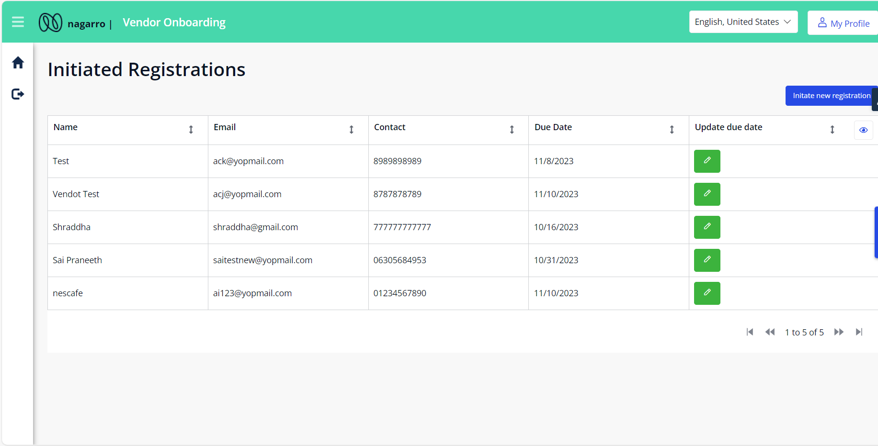
Vendor Onboarding –Registration Overview (Initiator)

Slide 9
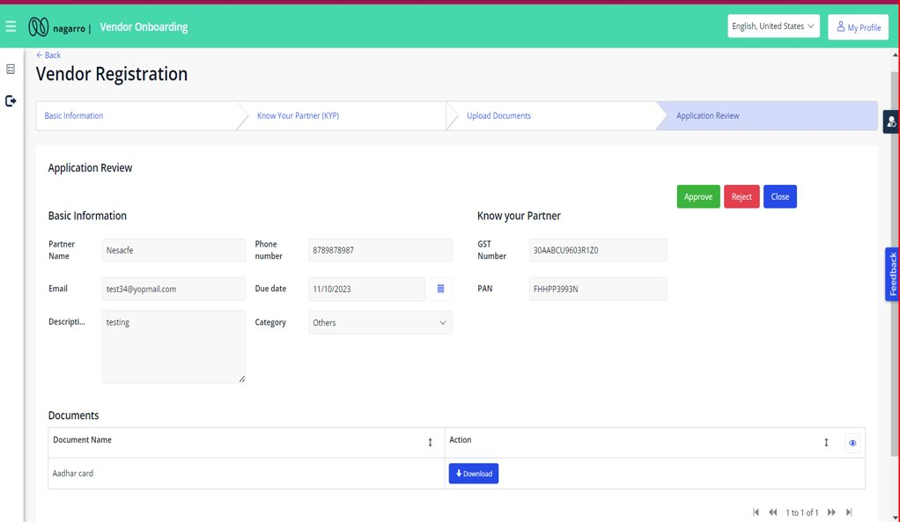
Vendor Onboarding –Application Review (Approver)

Slide 10
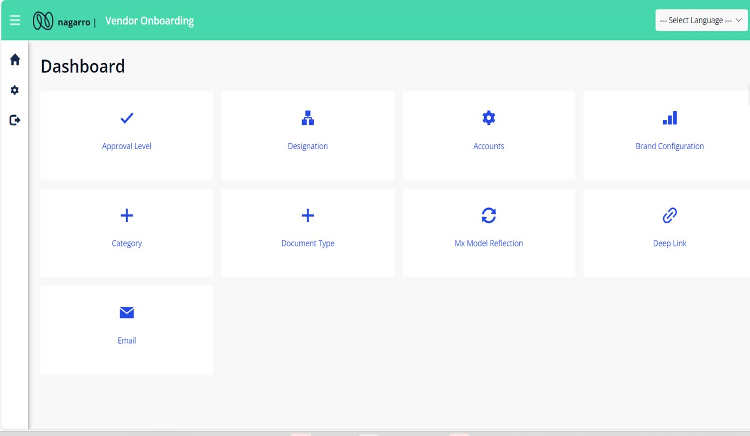
Vendor Onboarding –Admin Dashboard

Slide 11


Architecture Diagram
Mendix Runtime Engine
User Management
Initiator vendor Request
Application Logic
Login
Security Layer
Import/Export/Mail Data
Model Driven Development
Vendor management
Dynamic level of approvals
Document Mangement
Nanoflow
Microflow
Domain Model
Request
Vendor Status Tracks
Audit Trail/Loging
Browser Access
Customize theme
Multilanguage support
Response
Integration Layer
Integration Layer
Mail Server Integration

Slide 12
Thank You

Slide 13
Features
Registration and Profile Management
Authorized user can initiate the vendor registration process
Duplicate check
Ability to set the end date for registration at the time of initiation
Temporary account creation for vendor to access the registration form
Email notification to vendor containing the link to the registration form credentials to access it
Ability to save the application as draft
Registration and Profile Management
Authorized user can initiate the vendor registration process
Duplicate check
Ability to set the end date for registration at the time of initiation
Temporary account creation for vendor to access the registration form
Email notification to vendor containing the link to the registration form credentials to access it
Ability to save the application as draft

Slide 14
Initiator can submit request for vendor.
Vendor will get login details on mail. So that he can further update details.
Vendor can login based on that values and complete their Registration.
Save as a draft option on vendor form.
Unique registrations can only be initiated(Based on Email).
Notifying Approvers that a Registration is submitted
Approver dashboard to approve and reject requests.
Next level approvers will be notified if approved by previous approver.
Reminders for approvers .
Document type can be configured according to nation by Admin.
Number of Approver levels can be configured by Admin
Dynamic level of Approvers, which could be configured by Admin.
Approver level can be set based on designation where all users of that Business role will be marked to defined Approver level.
Brand configuration.
Multilanguage support.
Upcoming
Validations and verifications of government IDs PAN,GST,CIN,URN
Features

